Slide 1
05 – Operation and Security

Slide 2
Network centric real time OCS system
Real time OCS for multitude of real time services
With full built-in measures
Pre-integrate solution

Slide 3
Platform Concept
The product is built based on the following concept of high availability
Network centric real time OCS system
Deployed in the ‘lights-out’ environment of the Operators Central Office
Operators demand 24x7 SLA Real-Time Services Availability
Comverse is compelled to engineer the C1-RT to guarantee High Availability
Real time OCS for multitude of real time services
Real-Time Rating, Charging, Promotions for Voice, Data, and Messaging
Network Interfaces to CAMEL Voice/SMS/GPRS, Diameter (DCI/DPS)
Network Self-Care (IVR, USSD) for Announcements, Recharge & Info Server
With full built-in measures
Ensures that there is no single point of failure for any real-time services
Subscriber population in any system is partitioned into separate SDP
Failure of a component (in parts or whole) may not impact all the subscriber
With common platform management & remote service manager (for bulk/automatic software image upgrade)

Slide 4

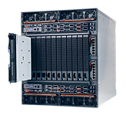
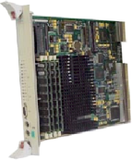
Platform Redundancy
Layered
Optimized HW for H/A
Horizontal Scalability at each layer
ONE Management
Rating and Balances Servers
Rating Server (SDP)
Rating Server (SDP)
N+1
2N
1+1
SDP
Rating Server (SDP)
…
Rating Server (SDP)
2N cluster
ONE Single API
Unified Rating Engine
Product Catalog
ONE Platform Management
SCP/OCS
Load sharing
Gateway Units
SCP Cluster
OCS Cluster
Offline CDR Cluster
SS7
Gateways
Diameter Gateway
(N+N) active-active
Multiple clusters can be deployed for higher scalability & availability
Network Layer
TCP/IP WAN
SS7 Network
Data / Content Network

Slide 5
To reduce complexity and minimize the cost of delivery and support, the Unified Platform provides a unified infrastructure that allows for a single set of operations, administration, and maintenance (OAM) functionality across the solution

Slide 6
Centralized Platform Manager
The Unified Platform architecture consists of a centralized Unified Platform Manager (UPM), a Unified Platform Agent (UPA) on each managed node, and client interface(s).
The design of the Unified Platform Manager, as well as the Unified Platform Agents, is based on a service-oriented architecture.
The Unified Platform includes services that provide the following:
Event and Alarm Management
System Inventory Management
Log and File Management

Slide 7
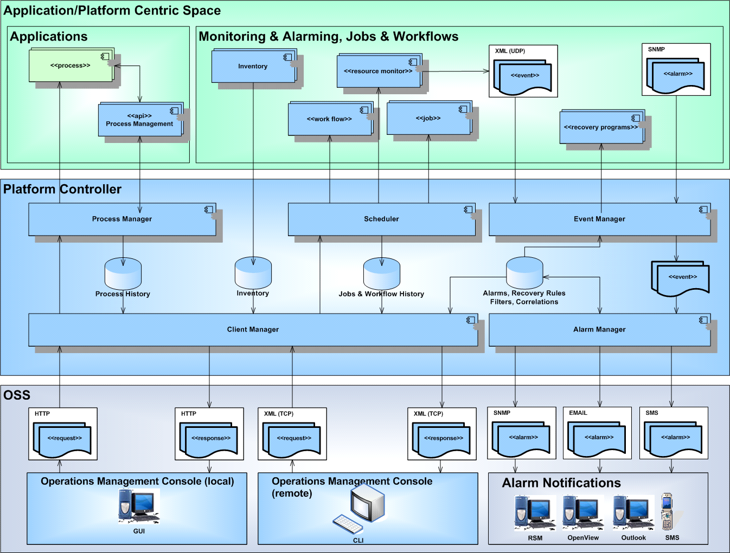
OA&M Architecture

Slide 8
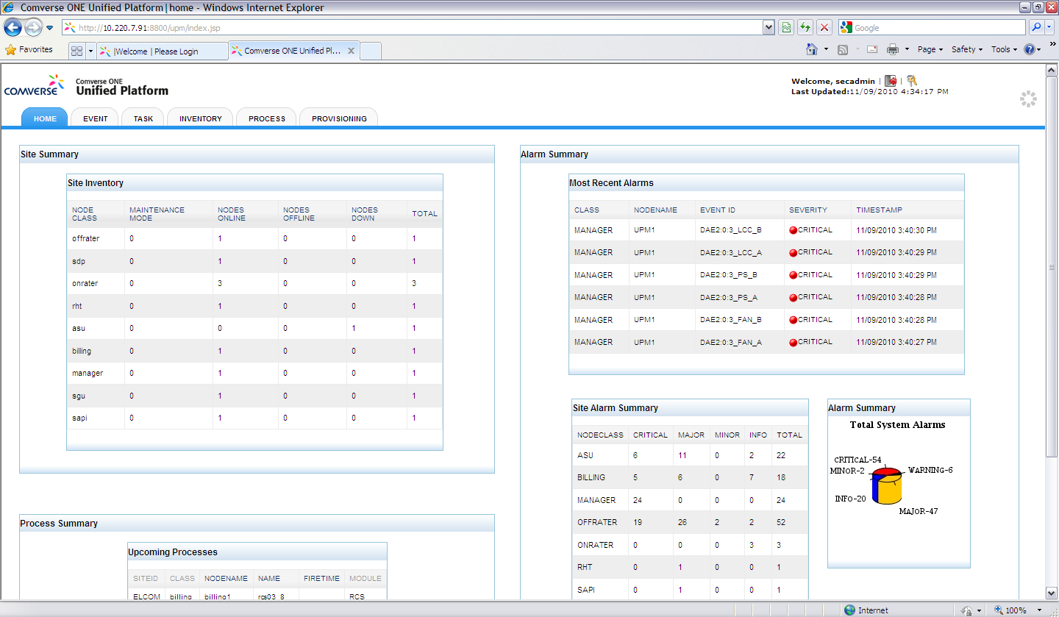
Unified Platform – Console screen

Slide 9
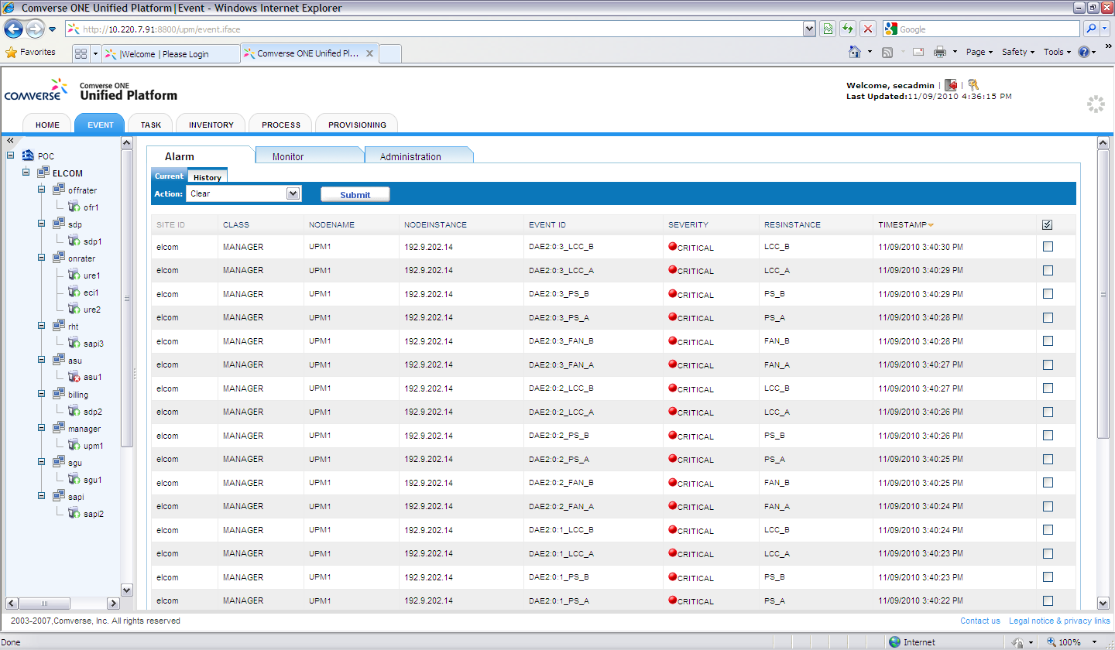
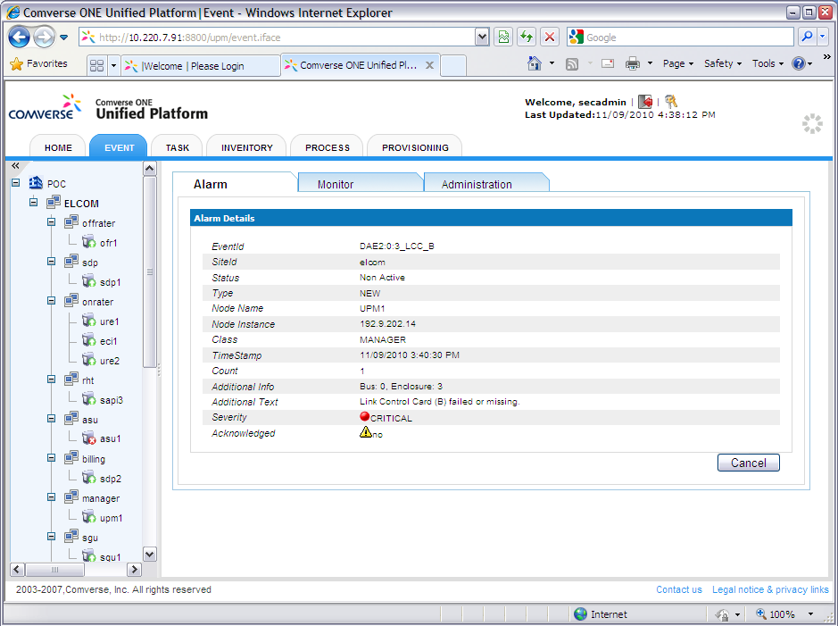
Unified Platform – Alarm Management

Slide 10
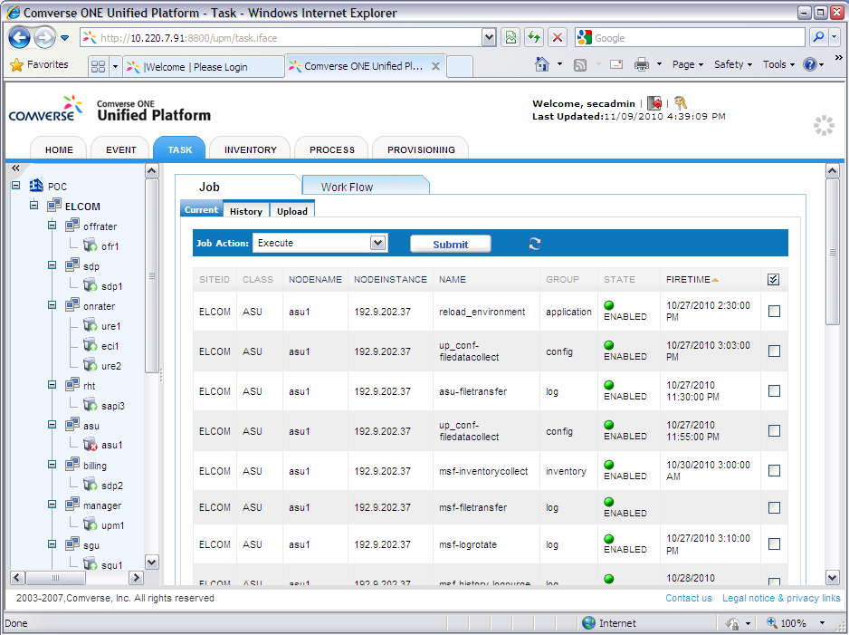
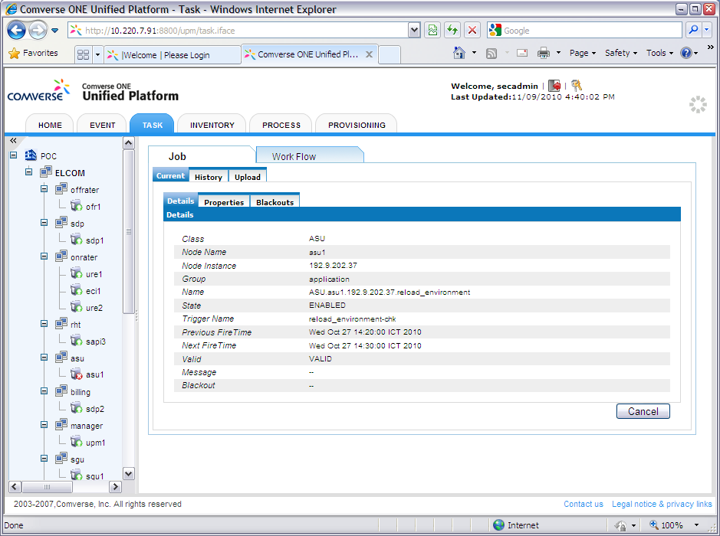
Unified Platform – Job Management

Slide 11
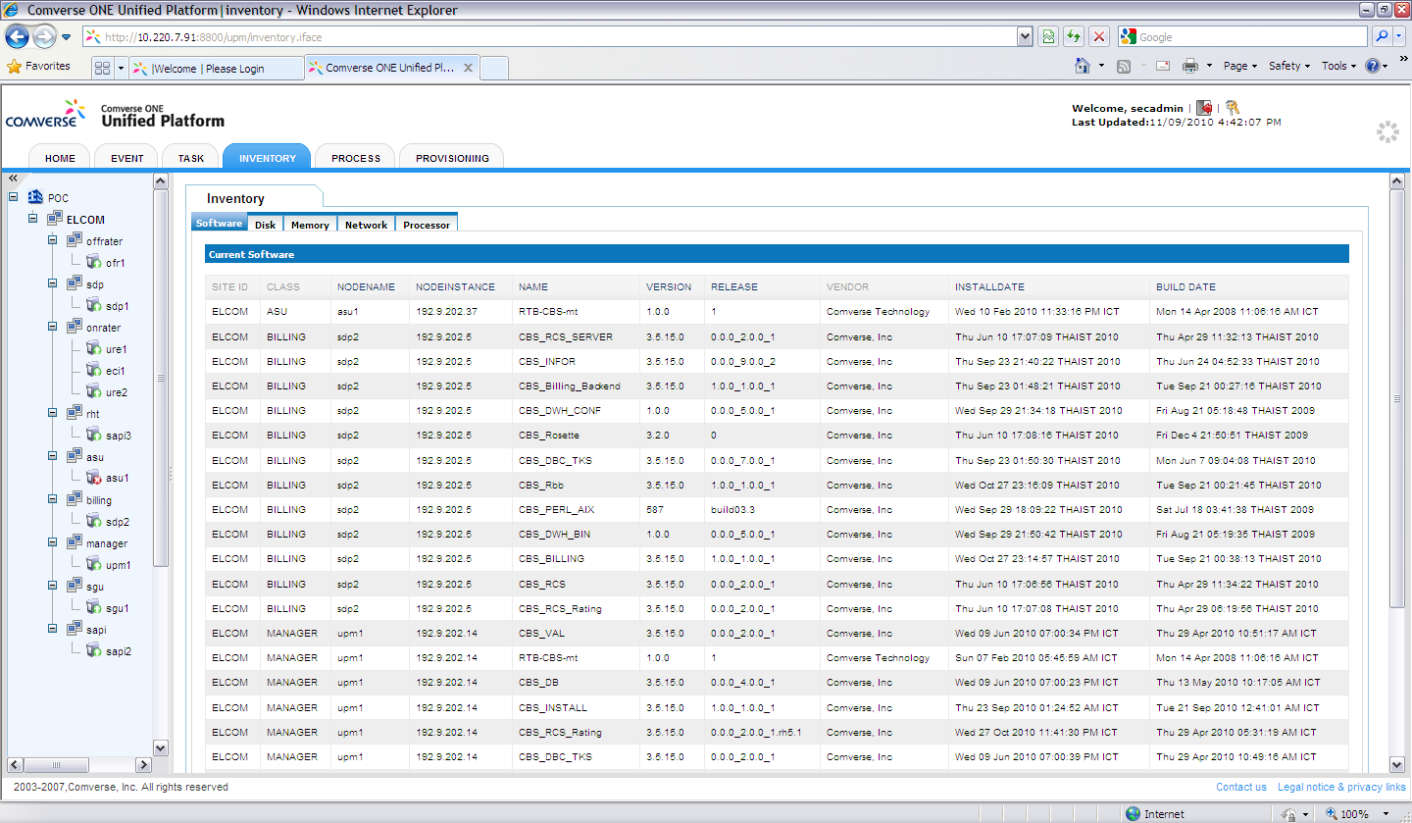
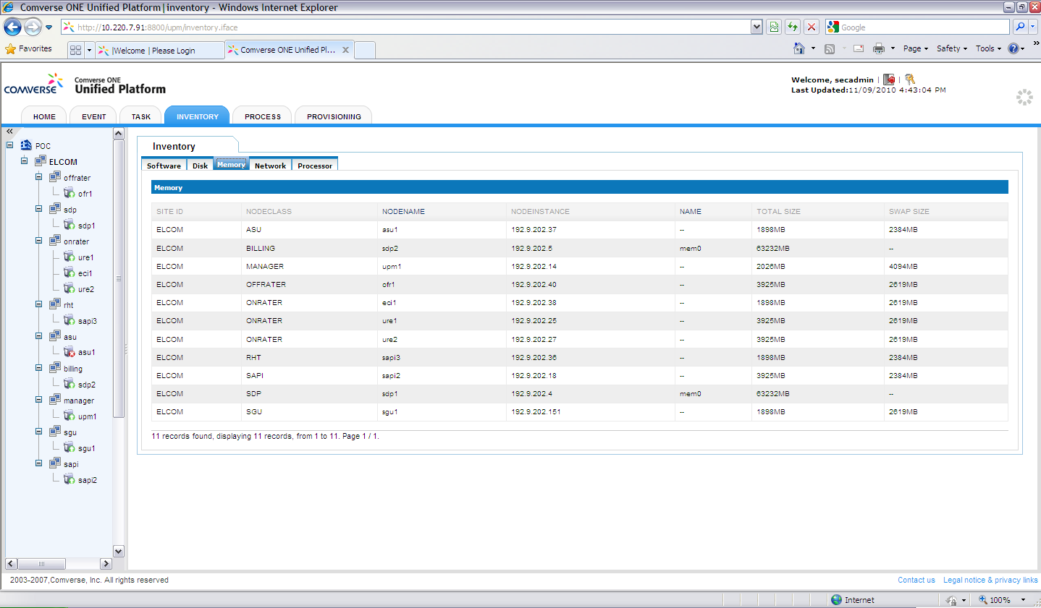
Unified Platform – System Inventory

Slide 12
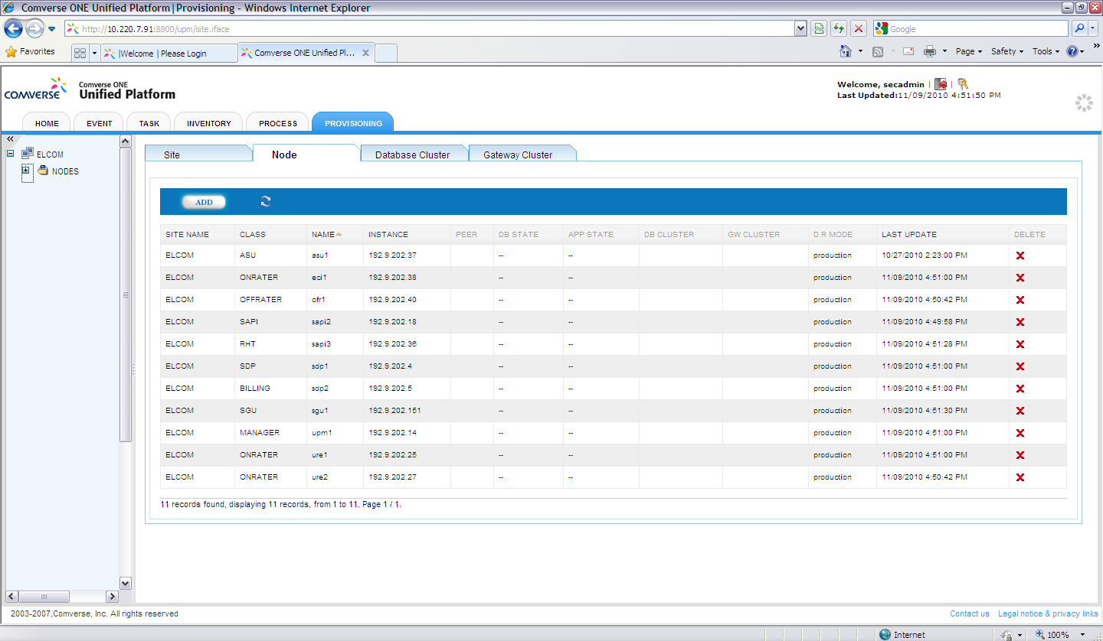
Unified Platform – Site Management

Slide 13
Recommendation
Recommendation
Recommendation
Please consider the following
The standard OAM will be provided
If VNP prefers, the alarm/trap can be shared to NOC via the SNMP
Platform statistic can be retrieved from the platform management for further analysis purposes.

Slide 14
System Security

Slide 15
The solution provides a security platform that supports Operator’s efforts to become or remain compliant with the Sarbanes-Oxley Act of 2002 (SARBOX).

Slide 16
Security overview
The Security platform does the following:
Supplies appropriate controls to ensure that any changes to the system related to financial control or financial data are monitored and audited.
Follows industry best practices and standards for authentication, authorization, and accounting (AAA).
Provides centralized key management for symmetric encryption keys and centralized database password management.
Provides integration points to allow for interfacing to CAT’s existing security infrastructure or, if no infrastructure is in place, provides a security infrastructure for components external to the system.

Slide 17
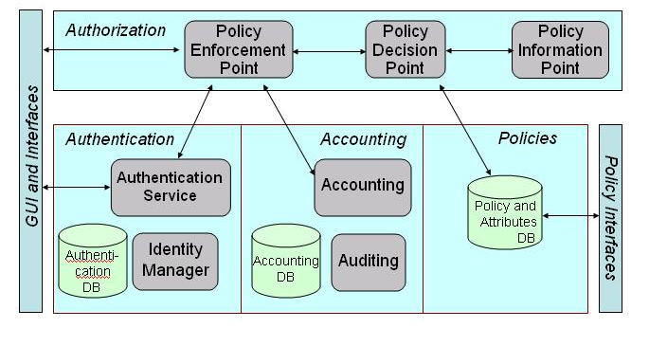
Security Architecture
The Comverse® ONE™ solution provides a common security framework that is leveraged across the entire C1-RT solution. The security framework provides centralized authentication, authorization, and accounting capabilities that can be used to enforce security needs of the business. The common approach to security across the solution gives the technical foundation necessary to help providers meet Sarbanes-Oxley Act of 2002 (SARBOX) requirements and other regulatory directives.

Slide 18
Comverse ONE: Security Infrastructure
Overview
Checks and balances in the system to ensure accurate financial reporting
Controls to monitor and audit any changes to financial control or financial data
AAA based on industry best practices and standards
Capabilities
Role Based Access Control (RBAC) for the End-Users of the System
Policy Based Access Control (PBAC) for the Public API I/F
Security Assertion Markup Language (SAML) for Authentication
eXtensible Assertion Markup Language (XACML) for authorization
Distributed Audit Service (XDAS) for Normalized Record Format
Business Value
Support operator in meeting obligations under SARBOX (or similar) legislation
Support operator in meeting obligations to comply with PCI-DSS standards
Single Security Architecture for both Central Office and Back office Applications
Pre-integrated Solution that can integrate with customer existing infrastructure.
Turnkey Solution that customers can leverage for non-Comverse applications

Slide 19
Comverse ONE: Security Framework
Identity Management & Authentication
Enforces password management and policies
Uses Oracle Database to store security credentials
Supports Web based interface for management of security credentials on-site
Security API provides mechanism for applications to retrieve Security Server Public Key
Policy Management & Authorization
Authorization is the process of determining if a subject, once authenticated, is permitted access to a given resource.
When policies are defined for Solution components, they are associated with security roles, and it is these roles that are allowed or denied access to resources. This type of policy definition is considered Role-Based Access Control (RBAC), and it is the primary policy model used by solution.
Audit Management & Accountability
Audit management is defined as management of the user activities that occur throughout the solution that directly or indirectly affect financial data or controls.
Audit management provides Comverse ONE components the ability to create auditable activities checks and balances in the system to ensure accurate financial reporting
Data Encryption & Credential Management
The data encryption framework is a set of interfaces provided by the Security Server API for the purpose of encryption and symmetric/asymmetric encryption key creation.
Application symmetric encryption keys are stored centrally at the Security Server.

Slide 20
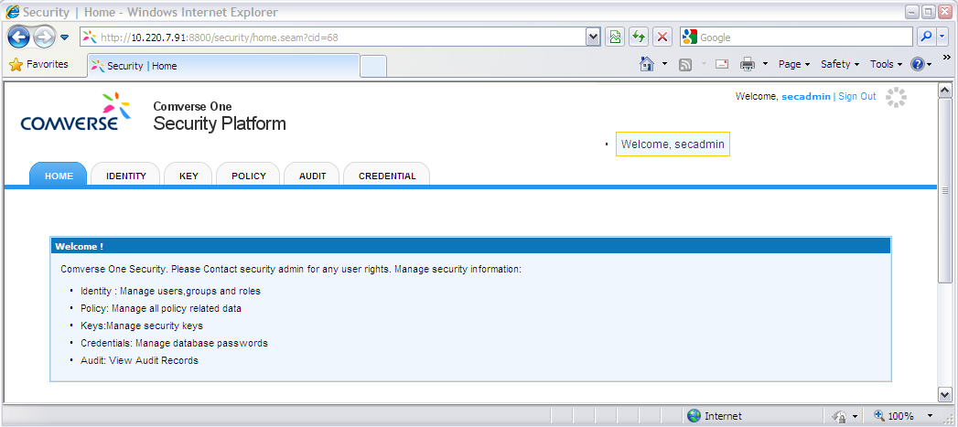
Security GUI
The Security graphical user interface (GUI) is a Web-based interface that is accessed via a standard Web browser. (Supported browsers are Internet Explorer and Firefox)

Slide 21
Security keywords
Security Realms
A security realm determines the scope of security data. A realm is the region to which a security ID or permission applies. A user defined as “John” in one realm is treated differently from “John” in a second realm, even if these two “John” IDs represent the same human user.
Security realms in the solution are usually scoped by application component because many job assignments are typically associated with an application.
Security Roles
A security role is a privilege granted to groups of users based on specific conditions. By its association with a realm group, a security role allows you to define access to resources for multiple users at once, based on their realm group membership.
Security Realms Group
A security realm group provides further scoping (that is, segmentation) of users within a security realm. Security realm groups are used for the following main purposes: (1) to provide common attributes to be associated with a subset of users in the realm and (2) to provide one or more security roles for that group of users. This further segmentation of users within a realm can be useful in certain scenarios where users can have various levels of privileges within a realm.

Slide 22
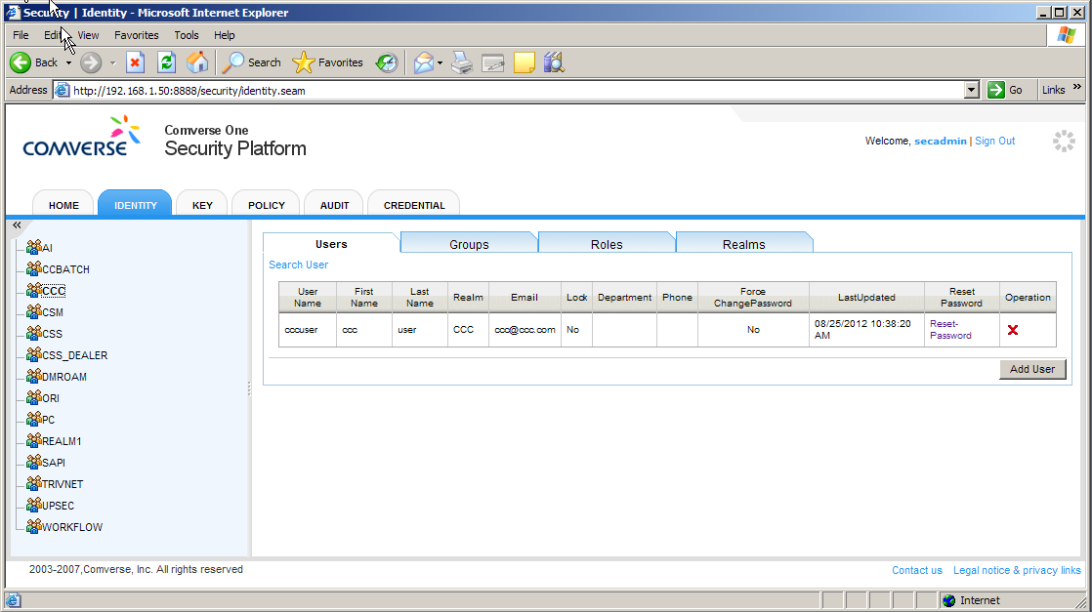
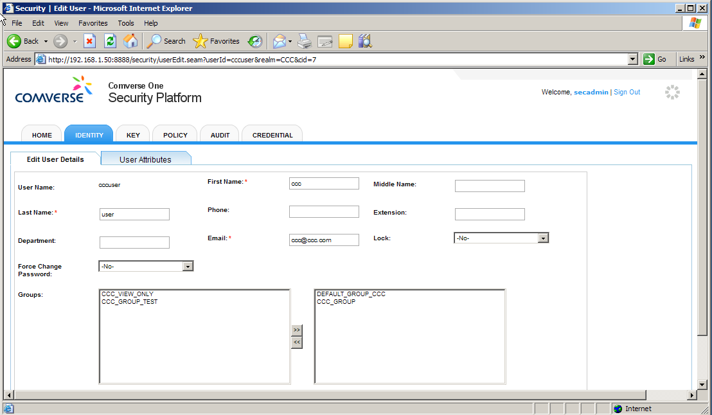
Identity Management
Identity Management allows user to perform/manage the following of each application domain
User Accounts
Security Realm Groups
Security Roles
Security Realm Roles
Application Domain
CC/ePOS username
Notes:
Update with the real screenshots

Slide 23
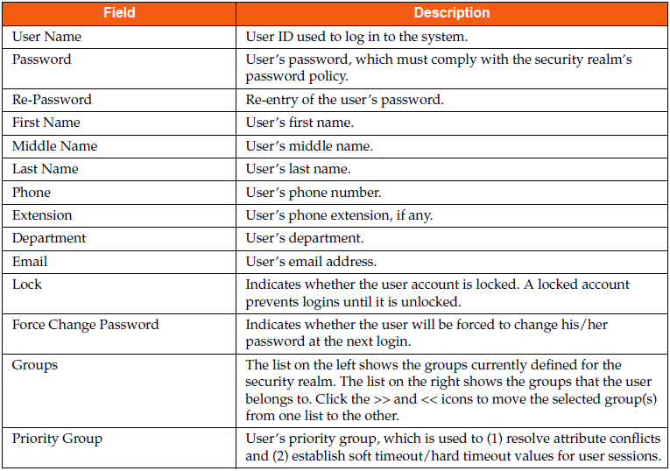
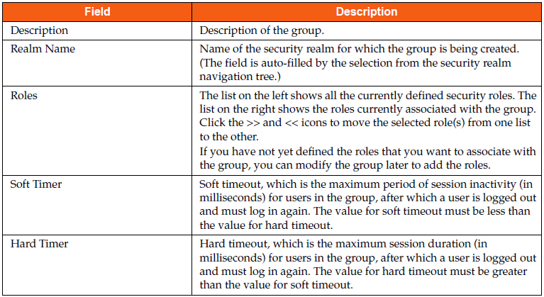
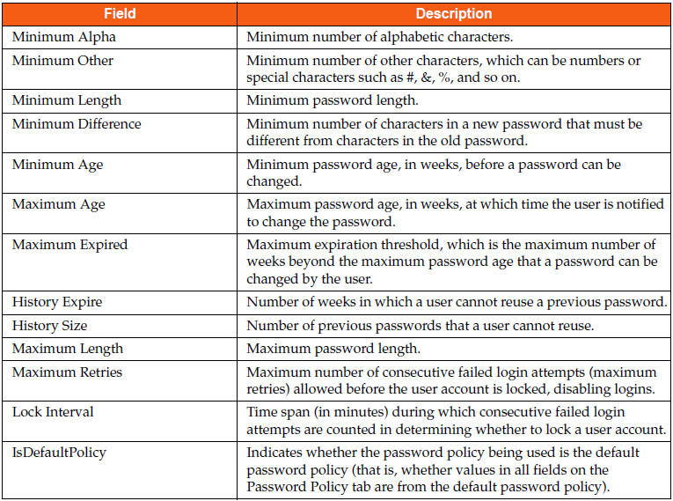
Identity Management – Password Policies

Slide 24
Policy Management
Policy management operations enable user to work with the following:
Authorization Policies: Policies are defined per security realm
Authorization Rules: Rules are independent of security realm

Slide 25
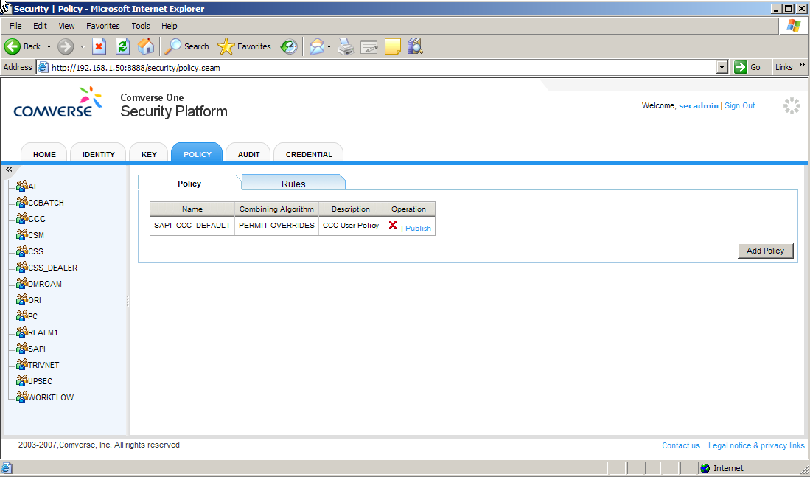
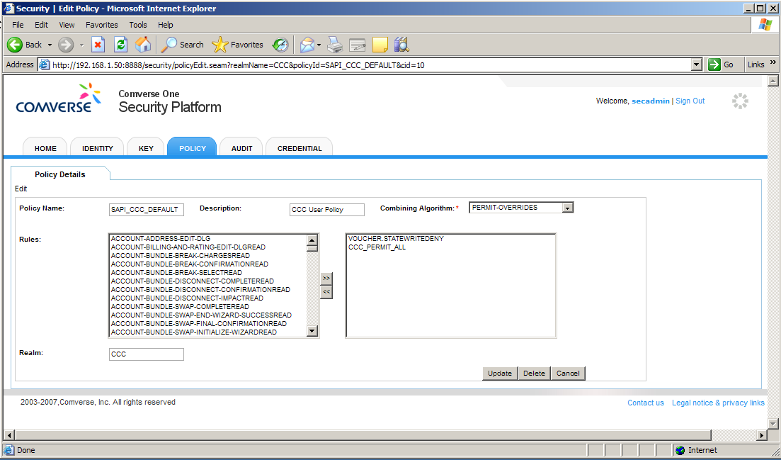
Policy Management -- Policy

Slide 26
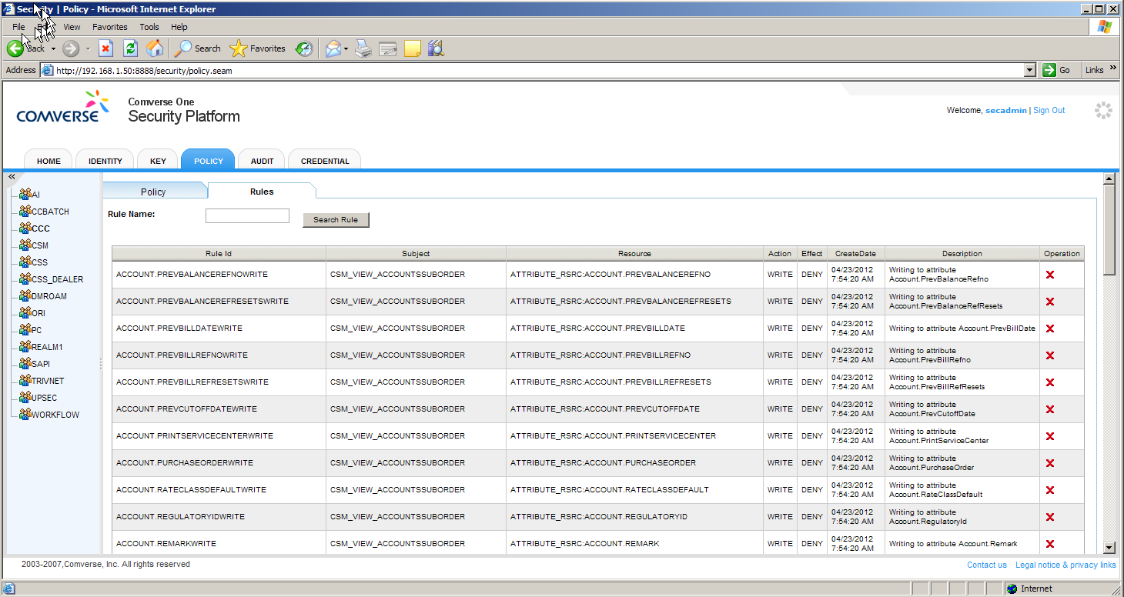
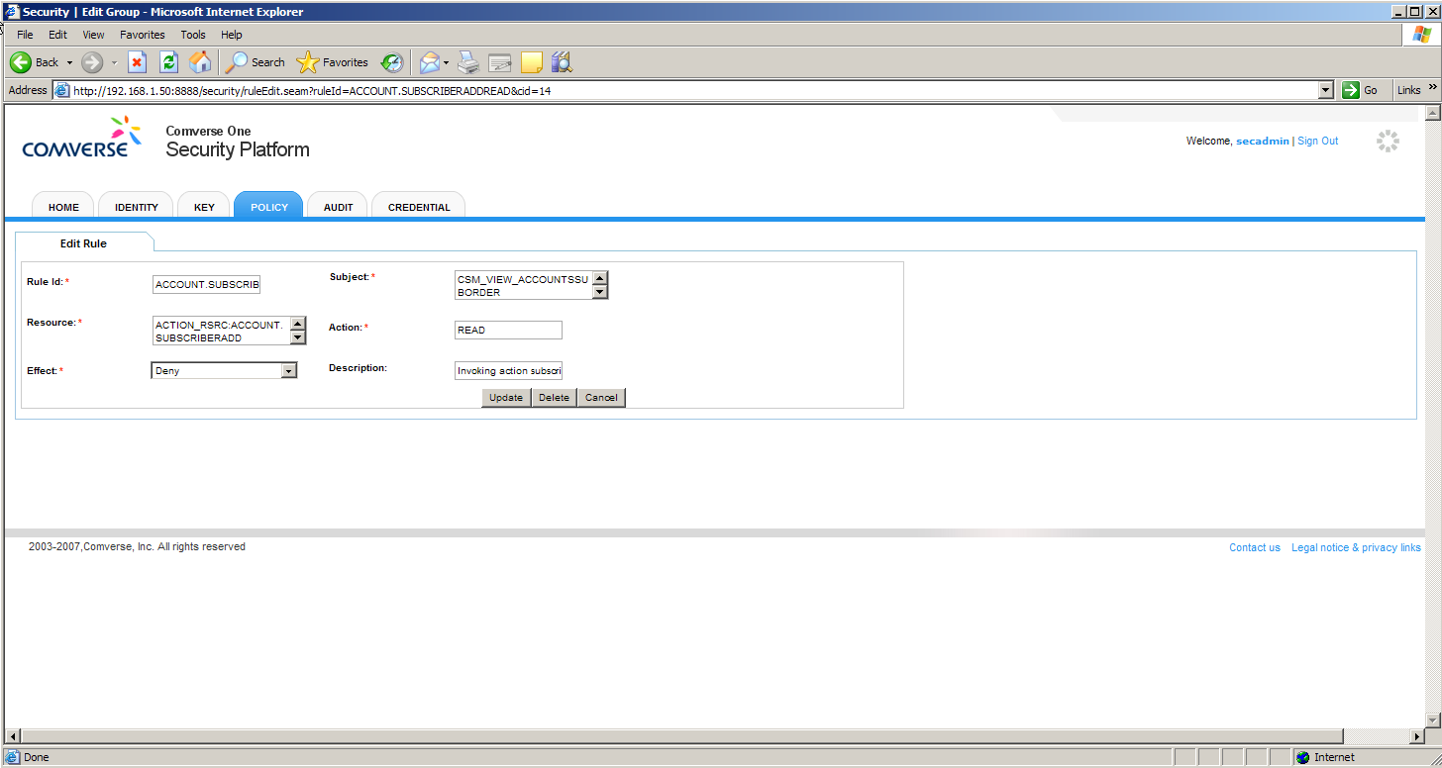
Policy Management -- Rules

Slide 27
Audit Management
Audit management provides complex systems the ability to centrally log data in a consistent format for the purpose of post-incident analysis in the event of application system security breaches or for root cause analysis (RCA).
Comverse’s audit management solution is primarily focused on SARBOX security audit information for the purpose of your organization’s security audits. This means that Comverse ONE applications audit activities that directly or indirectly affect the financial data and reporting of the system.
For audit management purposes, the Comverse ONE solution uses the audit record format, audit event/event outcome codes, and client API defined in the Distributed Audit Service (XDAS) specification.

Slide 28
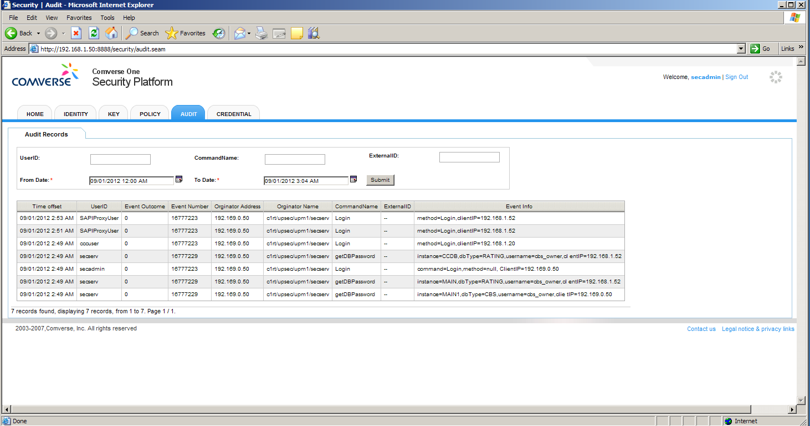
Audit Management -- GUI

Slide 29
Requirement from VNP
<NT>
Insert initial analysis of User&Identity requirement here

Slide 30
Recommendation
Recommendation
The security set up on the CAT environment will be
Follow the standard policy which are based on SARBOX recommendation
The Audit management will be enable in order to track the system access activity
The Dedicate security team is only allow to operate security server
Focusing on the following security related on Identity Management
CCC users (for Customer Care)
SAPI users (for SAPI application)
PCAT users (for PCAT admin)
We will need to agree on security requirements information which will cover
List of users for above domain
Authorization level for example:
CCC basic inquiry (for junior CSR personal)
CCC supervisor (for supervisor with adjustment capability)
CCC super user (with full administrative function)
PCAT administrative (modify only)
PCAT Super users (administrative level, plus with super user function such as create/delete)
SAPI users for inquiry related API function
SAPI full API access function
Agree on the password policy

Slide 31
Thank you

